Slide 1
ACT
Non-College Reportable
2025-2026
FALL: Event 2 (10/28/2025 – 11/07/2025
Notes:
Update contact list
Cost
*NOTES FROM LAST YEAR!
Talk about irregularity reports. Don’t invalidate a test just because a student misses the 2nd day of testing – ACT will score the part that he completed.
Notify us if you have any of these so that our numbers are correct when we verify the results
If the test administrator does not know the student you MUST verify the student’s ID!

Slide 2
Changes
We are still using ACT Success for score reporting and regular Accommodation (TAA) requests
ACT Now is the new online tool for test event planning (like Bluebook for College Board)
Test Center Manager (TCM) is where you manage staff, rooms, and assign students
Materials are labeled with Event Dates and are only good for that Event window

Slide 3
Reminders
Students only have to take the sections that they need to meet graduation requirement
All students must be listed in ACT Now to test (issued an ACT ID)
  Check your upload extract in shared drive to verify who is uploaded
  Students MAY be automatically assigned to the Test Event in ACT Now
    You will need to check and assign if needed
  You can/should have a list that you are working with from FOCUS

Slide 4
Accommodations Allowed
ACT-authorized accommodations allow you to test under seven different timing codes:
• Standard time
• Double time over multiple days
• Triple time over multiple days
• Standard time over multiple days
• Breaks as needed
• One and one-half time
• One and one-half time over multiple days
• Standard time multiple choice, double time writing section only, single day
Note: In the NCR-only administration, all timing is defaulted to allow triple time. You must manually time the test if a different timing code is used.

Slide 5
Accommodations, 2
Non-college reportable accommodations and/or supports are available to:
• Examinees who do not meet the eligibility requirements for ACT authorization.
• Examinees whose request for ACT authorization is not approved.

Slide 6
Authorized Timing
All examinees in the room must have the same authorized timing. Examinees testing with accommodations may not test in a room with examinees who have different authorized timing. If they do, tests from that room will not be scored or scores will be canceled.
Important: When testing with accessibility supports, examinees may use less time than allowed with their authorized timing. Do not move to the next test until the standard time has expired and all examinees in the room have completed that content area, or the allotted time has expired.

Slide 7
Students to Test
Evaluation Services will Pre-ID ALL grades 10(R)-12 students who have not yet met:
  ELA mastery (graduation) and who have attempted
  Algebra 1 mastery (graduation)
Ensure you are using the FOCUS enrolled grade, not the grade where a student “should be”!
Not a mandatory test, so schools must notify parents and allow them to opt out

Slide 8
Examples
Heather is a 12 grade student who has not yet met her FSA ELA mastery.
  She needs to take ENGLISH and READING on the ACT-NCR ONLY (in order given)
Nate is an 11th grade student who has not yet met his Algebra EOC mastery
  He only has to take the MATH section on the ACT-NCR
Robin needs both FSA ELA and Algebra 1 mastery to graduate
  She must take ENGLISH, MATH, and READING (In correct order given) on ACT-NCR

Slide 9
Preparation –
General
Receive and inventory Non-College Reportable materials
Keep your boxes for returning materials
Apply barcode labels to answer documents in designated area
Hand grid student information if you don’t have a label
Store materials securely
Train test administrators/proctors
Email Heather the date your school plans to test

Slide 10
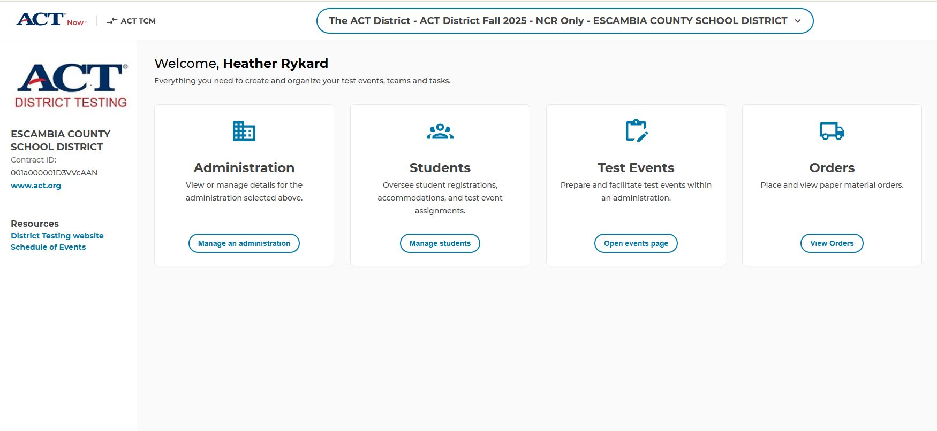
ACT Now

Slide 11
Preparation -
Staff
Room supervisors and proctors may be current or retired faculty members, school admin or clerical employees, substitutes, student teachers, or paraprofessionals
May not serve as test coordinator if a relative is testing in the ACT window
Relative is: children, stepchildren, grandchildren, nieces, nephews, siblings, in-laws, spouses, and persons under your guardianship.
Staff must remain attentive to their testing responsibilities throughout the administration

Slide 12
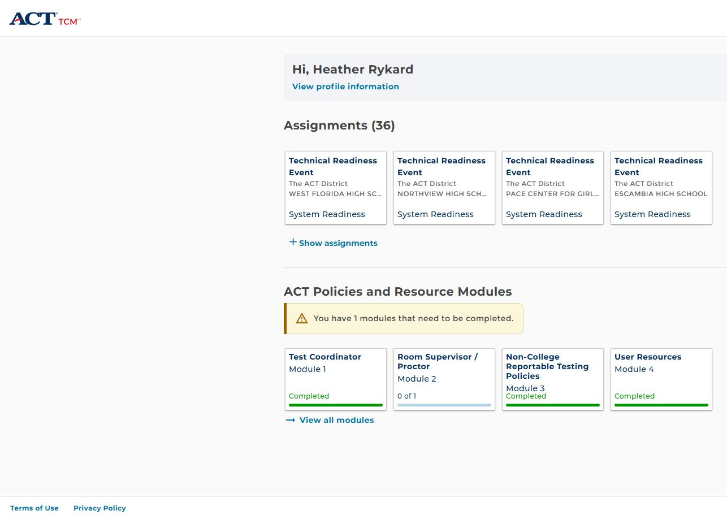
ACT Now – TCM

Slide 13
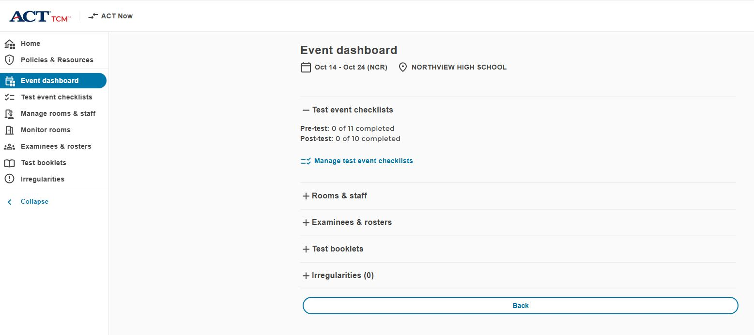
TCM – Event Dashboard

Slide 14
Test Event Checklists
Agree to Training Modules in TCM
Have Student Complete myACT Accounts
Receive, Secure, and Check-in Test Materials
Select and Set Up Test Rooms
Complete Event Set Up in TCM and ACT Now
Access Rosters and Assign Examinees in TCM
Print Check-in Rosters
Prepare Your Facility
Distribute Test Materials to Room Supervisors

Slide 15
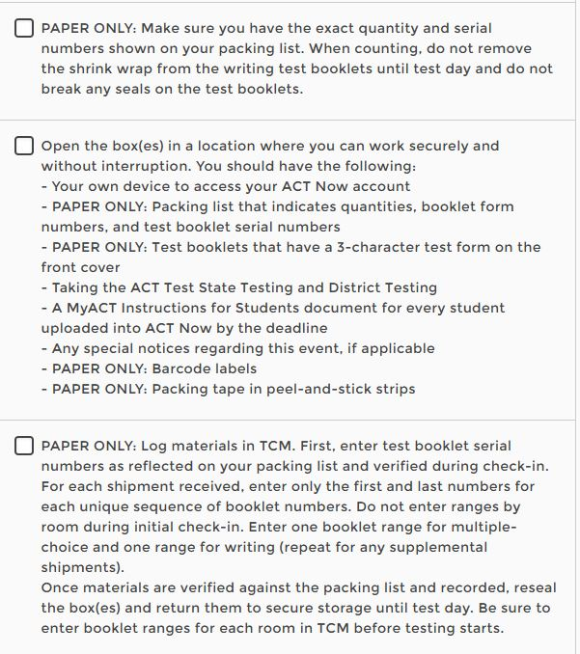
Receive, Secure, and Check-In

Slide 16
Receive, Secure, and Check-In
Test materials are sent for a specific event and type (regular or NCR).
Schools must ensure they use correct materials during the test window
Secure
  Test Books
  Barcode labels
  Pre-recorded audio URL
    Note :Do not read tests to examinee or play the pre-recorded audio to a group.
Non-Secure
  Answer documents
  Applicable supplements (i.e. Calculator Policy)
  Site Header
  Return materials

Slide 17
Receive, Secure, and Check-in
Contact ACT immediately if:
  Items are missing from your shipment.
  You receive test booklets that do not match the serial numbers on your packing list.
  Test booklet seals are broken at any time (except by examinees as instructed on test day).
  A test booklet is lost, stolen, or otherwise missing (even if only temporarily) at any time.
  The materials appear to have been tampered with in any way.
  You have reason to believe someone had unauthorized access to the materials.

Slide 18
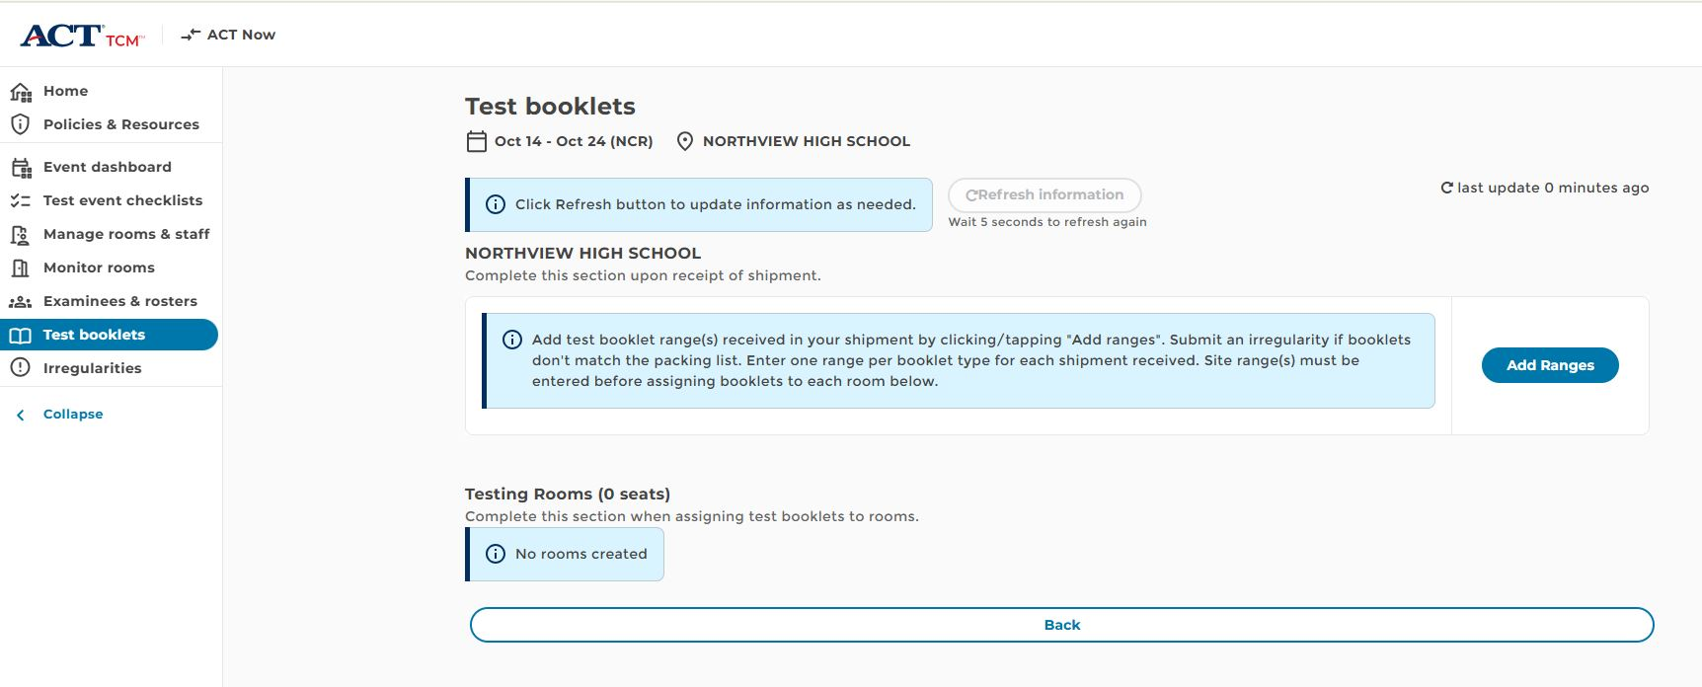
Test Booklets

Slide 19
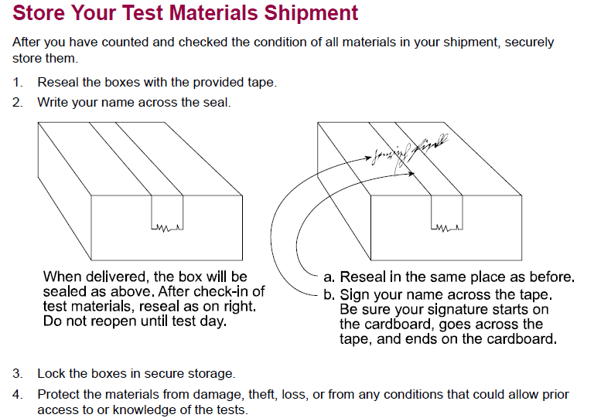
Receive, Secure, and Check-In

Slide 20
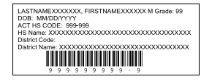
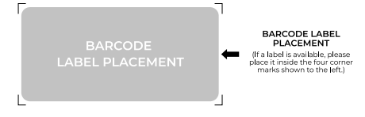
Preparation –
Materials
Check barcode correctness – if incorrect, manually grid the correct student code in Block U
Apply barcode in the correct location

Slide 21
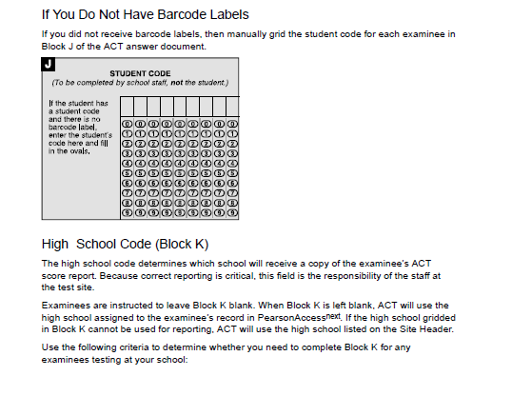
Preparation - Materials

Slide 22
Select and Set Up Test Rooms
Students should all face the same way
Spaced as far apart as possible
Students should be at least 3 feet apart
Aisle space allows room for staff to circulate
Carrels are not allowed
Remove visual aids

Slide 23
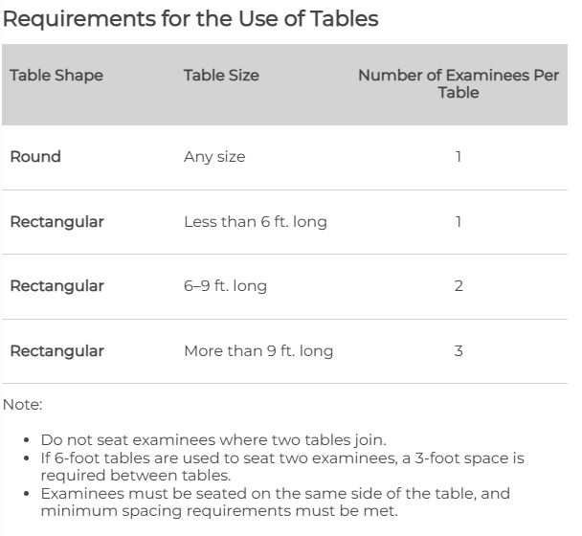
Table Requirements

Slide 24
Complete Event Setup in TCM/ACT Now
Create or copy rooms in TCM for each test event
Assign any staff already available in TCM
Invite new users in ACT Now
Assign test event staff to roles and rooms for each event in TCM
Download the printable test day instructions in the event there is an issue accessing TCM on test day

Slide 25
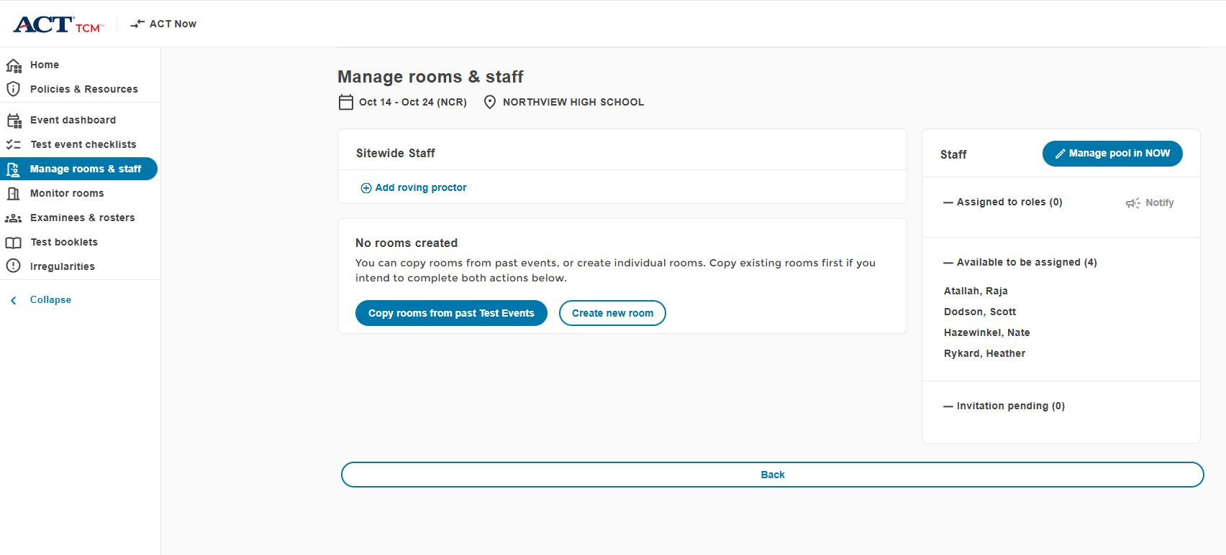
Manage Rooms & Staff

Slide 26
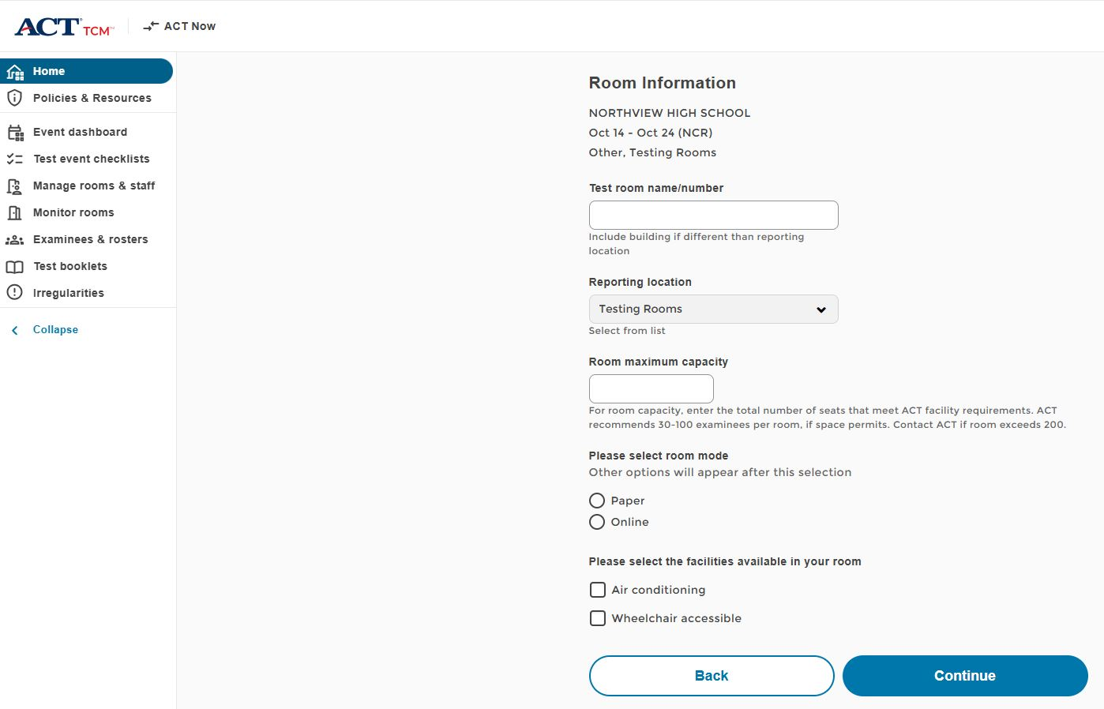
Create Room

Slide 27
Staff Accounts
Test coordinators must invite users (test event staff) to the administration in ACT Now. Test event staff must accept the invitation and create a user account in ACT Now.
All test event staff (room supervisors, proctors, and roving proctors) must have ACT Now user accounts to access TCM for training before test day and to administer the exam on test day. Please do not share accounts or create more than one account per person.

Slide 28
Preparation –
Staff Training
The test coordinator is responsible for providing training materials to all test center staff before test day.
The test coordinator, and room supervisor, must log in to TCM and complete the required training housed in TCM.
It is especially important that the room supervisors read and understand ACT policy and resource modules prior to administering the test.

Slide 29
Staff Training
Test coordinators hold a training session before test day to prepare test event staff (both new and experienced) for test day activities. This training session is required
Topics to Cover:
  Facilities Requirements and Setup
  Test Materials
  Non-Test Activities (Completing answer doc)
  Test Administration

Slide 30
Online Test Admin Materials
ACT Test Center Manager (TCM)
  This digital application, accessed through ACT Now, replaces the use of traditional printed ACT administration manuals by providing separate test coordinator and room supervisor policy modules on ACT policies, test facilities, test staff, test materials, test administration, and non-test activities. Pre- and post-test checklists are also included to make sure you are prepared for test day and ready to return materials after testing.
Printable Administration Manual
  This document contains all of the test coordinator policy modules found in TCM in an easy-to-read, printer-ready pdf.
Test Day Instructions for Paper Testing
  This document provides test day verbal instructions for paper testing in the event there are technical difficulties with TCM, or your site isn't using TCM on test day.

Slide 31
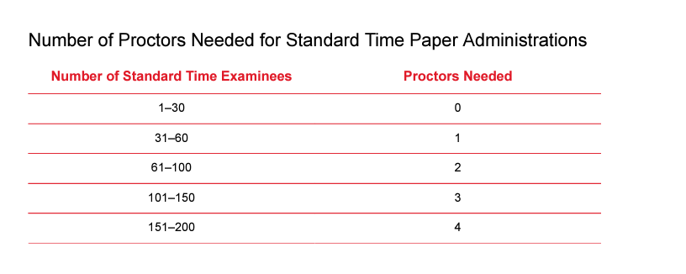
Preparation –
Proctors
**NCR Manual has 1-20 ratios, but we have permission to use standard time proctor rules per ACT.
Notes:
The proctor requirements are the same as the standard time test. Once you reach 50 students, an additional proctor is required for each additional 50 students.

Slide 32
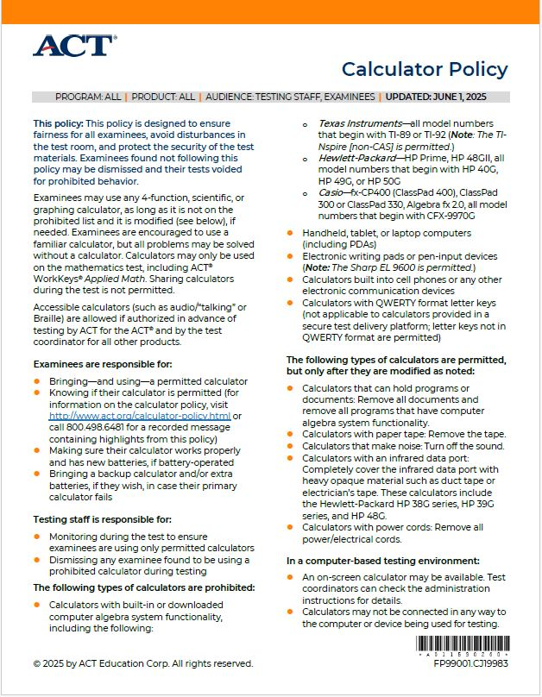
Preparation - Calculators
Make sure you are only handing out/allowing
authorized calculators
Policy prohibits sharing of calculators, so make
sure you have backups
If a student uses a prohibited calculator, the test
will be invalidated

Slide 33
Access Rosters and Assign Examinees in TCM
Select test day assignment in TCM -> Examinees & rosters
  Students are displayed by delivery mode
Assign examinees to test rooms
  All examinees in a test room (in a sitting) test as a group. They must receive the same verbal instructions, work on the same test, and take breaks at the same time. Assign examinees to separate test rooms accordingly. Tests will not be scored or scores will be canceled if this policy is violated.
To move examinees between rooms, remove from currently assigned and assign to new room

Slide 34
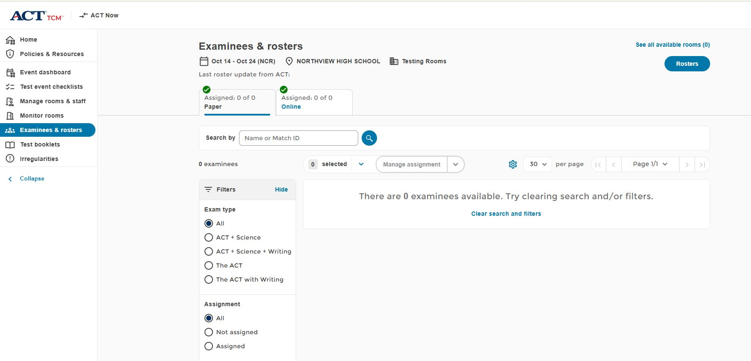
Examinees & Rosters
Assign students to rooms
by using “Manage Assignment”

Slide 35
Rosters
Click here to view
Or print rosters

Slide 36
Room Supervisor
Prepare for test day:
Accept the user invitation and create an ACT Now account.
Assist the test coordinator, as needed.
Attend the training and briefing sessions conducted by the test coordinator.
Review policy modules in TCM and additional training resources on your program's ACT-hosted web page.
Open room in TCM.

Slide 37
Room Supervisor
Check-in activities on test day:
Individually identify and admit examinees to rooms; verify IDs and mark the roster.
Remove absent students from the room in TCM.
Unlock student records.
Direct examinees to seats once admitted.
Make sure all examinees admitted to a room are assigned the same timing.
Make sure all examinees authorized to test over multiple days are ready to begin the same test.

Slide 38
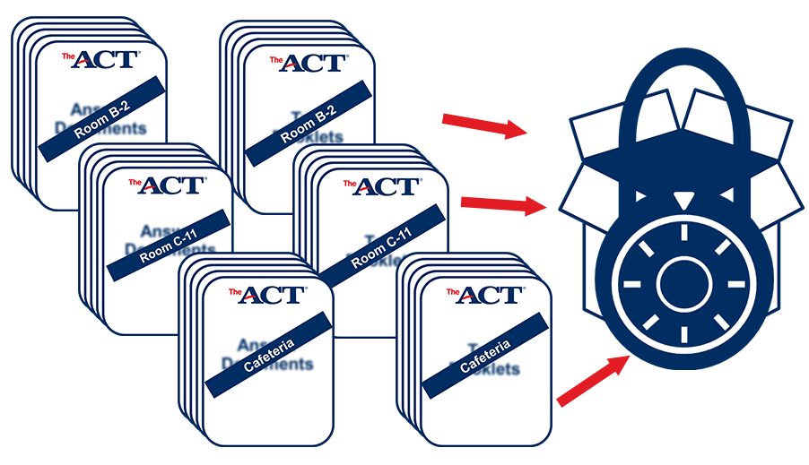
Test Day –
Room Materials
Printed script (correct timing)
Roster
Answer documents and test booklets by room
  Apply bar codes day of testing once students check in
Seating Chart (District req’t)
Room Details/Test Timings
Calculators
Pencils & erasers

Slide 39
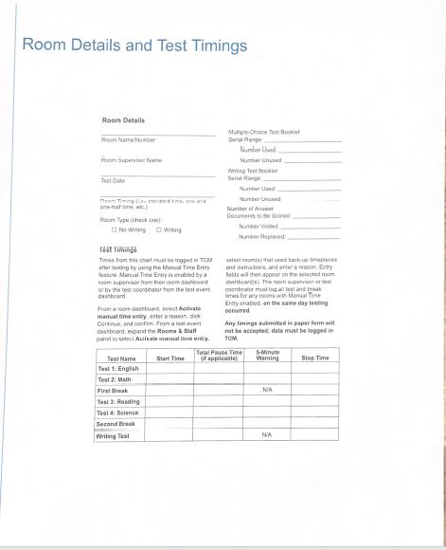
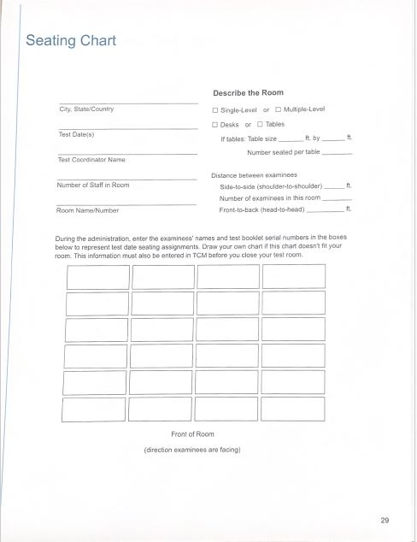
Test Day Materials

Slide 40
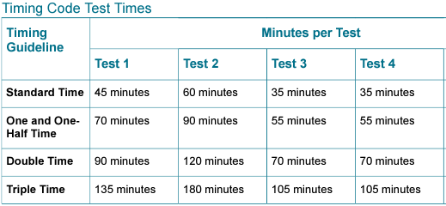
Timing Options
If using multiple days, each test must be completed in one session
English Math Reading
215/3.5
280/4.6
420/7

Slide 41
Test Day –
Timing Options
Time-and-a-half, single session
Time-and-a-half, double or triple time, over multiple days
  Session must be completed in same day (cannot split a session)
No Double/triple time, single day allowance. If a student has a double time, multiple day timing must be used.

Slide 42
Test Day –
Guidelines
Timing options – if not followed, complete Irregularity Report in TCM
Tests can be given in a Time-and-a-Half, Single Session/Multi Day, Double Time, Multi Day, or Triple Time, Multi Day
Whatever timing is chosen MUST be used for each subtest (cannot mix and match timings)
Students must take the tests in order
  (English, Math, Reading, Science)
Schools MAY opt to not give the Science subtest (not used for a concordant score calculation)
Lunch can be scheduled between tests
Notes:
Can move on once all students have finished that session – Eng (70), Math (90), Reading (55), Science (55)

Slide 43
Room Supervisor
Administer the test:
Take responsibility for a test room and provide an environment conducive to testing.
Read verbal instructions on task cards verbatim to examinees.
Monitor the TCM timer.
Monitor assigned test room in TCM.
Unlock the student records in TCM.
For one and one-half time testing, use the TCM timer to ensure the exact time is allowed for each test.
Lock each student in TCM if testing over multiple days. Note: Students should NOT be marked complete in TCM if the student will continue testing on a subsequent day. Rooms in TCM should not be closed if students are testing on multiple days.
Close room and resolve any alerts before marking the task as done.

Slide 44
Test Day –
Attendance
Staff MUST initial that they have verified student’s identity
List students “Actually Testing” in the room
List serial numbers of the test booklet(s) “Actually Used”
This is per ACT’s policy listed on their website

Slide 45
Test Day –
Handling Materials
Room supervisors will pick up materials from SAC
To ensure security of test materials, distribute to examinees ONLY when directed to do so in the instructions, not before
Be sure each examinee receives the answer document with his or her name on the barcode label or the student code gridded in Block U (another way to verify attendance)
Personally hand one test booklet individually to each examinee in sequential serial number order

Slide 46
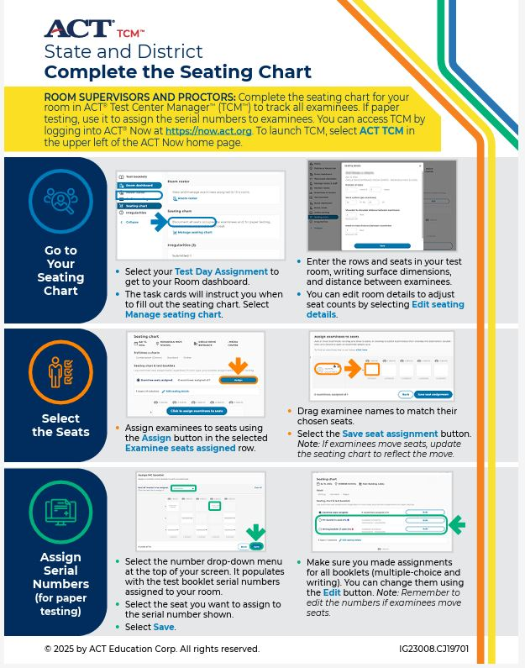
Test Day – Seating Diagram

Slide 47
Room Supervisor
Maintain security:
Keep test materials secure during testing and breaks.
Monitor for prohibited behavior during testing and breaks.
Submit irregularities in TCM.
Collect and account for all test materials before dismissing examinees.
Ensure complete documentation:
Complete all information in TCM, following the task cards.
Document irregularities in TCM and, as required, void examinees' tests.
Return all test materials to the test coordinator after testing.

Slide 48
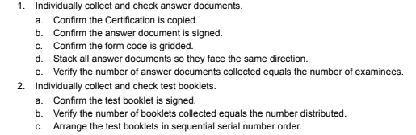
Test Day –
Handling Materials
After Testing, room supervisors must:
*Complete TCM Post-Test Checklist
**Also ensure grade level is filled/bubbled in on the answer sheet

Slide 49
Test Day –
Irregularities
Fill out the Irregularity Report for each occurrence of a group or individual irregularity (if there are none, do not submit IR)
Group
  Missing or stolen test materials
  Interruptions or disturbances
  Emergency evacuations
  Power outages
  Reschedules
Individual
  Handled online via TCM

Slide 50
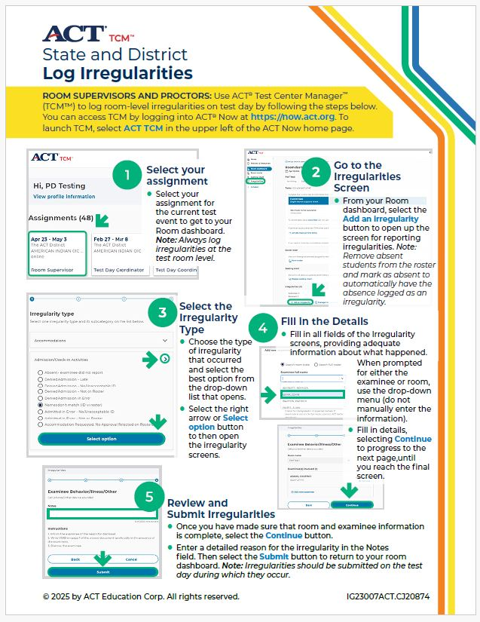
Irregularities

Slide 51
Test Day –
Reminders
Electronic devices are prohibited
Calculators are allowed during the math test only
Collect and pack materials after testing (see manual)
Answer documents must be in the envelope
Complete irregularity reports (if any)
Make copies of all admin records to keep on your campus
Return materials to ACT right away
Email Heather when you have shipped your materials

Slide 52
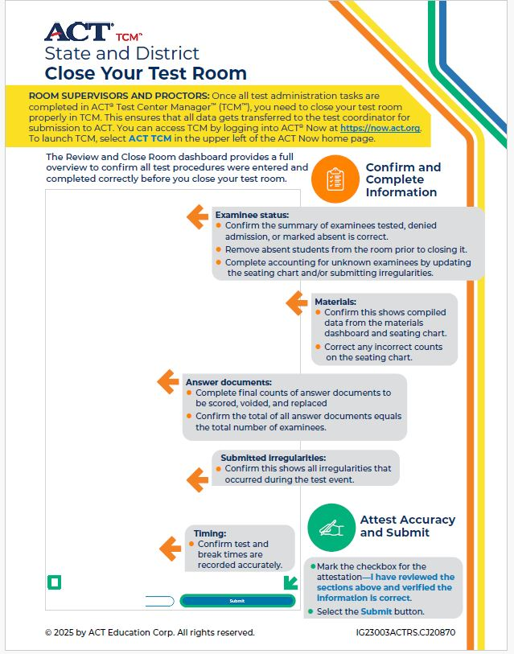
Close Room

Slide 53
Shipping
Immediately after the administration, return the test materials to ACT. Failure to return materials in a timely manner may prevent tests from being scored.
Instructions for how to collect, pack, and return materials to ACT can be found in your TCM Post-Test Event Checklist.

Slide 54
After Testing - Eval
Mark on your testing file which students tested/did not test in the shared Google Drive for your school
ONLY use column marked “Tested? Yes/No”
Do NOT edit/delete/add anything else to this file!

Slide 55
After Testing - Eval
Once you have tested, you may ship back all test materials – do not hold them at your schools
ACT will report scores at 4, 7 & 9 weeks – so the sooner your materials are returned, the sooner you MAY see your scores
If you need access to ACT Success, email Heather or Nate
Deadline for test file update is NOV 12, 2025

Slide 56
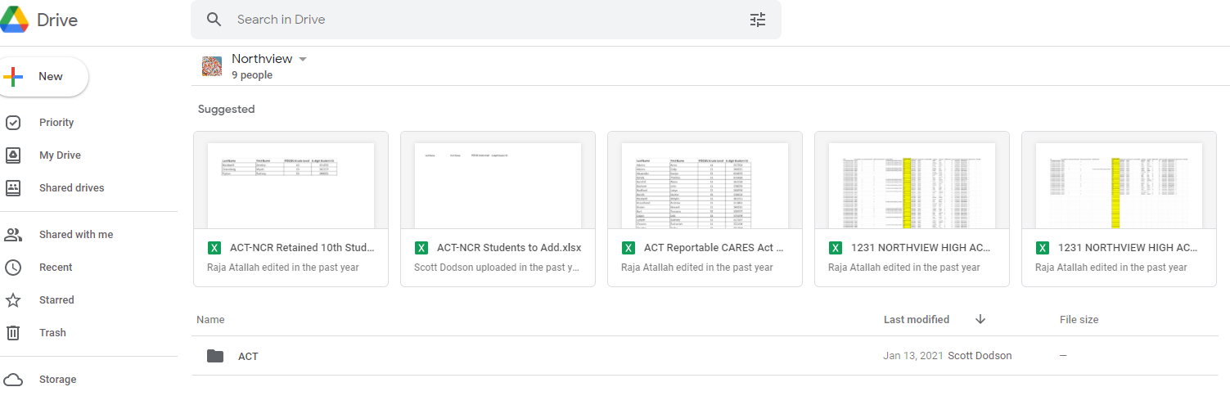
Google Drive

Slide 57
Payment
Schools are paying for these tests
We will send you a list of all students that were in the PreID (have not met the ELA/Algebra 1 grad requirement )
Immediately after testing 1) mark the students that tested in the shared Google Drive for your school
Eval Svcs will unenroll students that did not test

Slide 58
Questions
Contact Evaluation Services
  Heather Rykard (Test Procedures, Administration, Accommodations)
    850-469-5387
    hrykard@ecsdfl.us
  Scott Dodson (Pre-ID, Testing Data files, Score reporting)
    850-469-5389
    sdodson@ecsdfl.us

